Slide 1
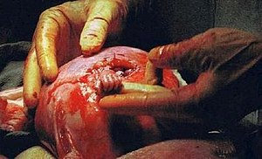
Abortion: What Does The Bible Say?
File:Samuel Armas Aug19 1999.jpg
Since Roe vs. Wade 1973, the National Right to Life Committee (NRLTC), says it reached an estimated 62,502,904 abortions, by tracking data from the Centers for Disease Control (CDC) and the Guttmacher Institute, (California, New Hampshire, and Maryland numbers are excluded from the data.)

Slide 2
Abortion!
Definition: “Abortion is the termination of a pregnancy by removal or expulsion of an embryo or fetus. ^{[note 1 ]}
Definitions of abortion vary from one source to another. Abortion has many definitions that can differ from each other in significant ways. Given the contentious nature of abortion, lawmakers and other stakeholders often face controversy in defining abortion. Wikipedia

Slide 3
Abortion: What Does The Bible Say?
Why This Approach?
Because God Exists! Hebrews 11:6; Psalms 14:1; Psalms 19:1.
Because Man was created in “the image of God.”
Genesis 1:26-27
  We do not suppose this is a physical likeness because God is not flesh and blood, but Spirit (John 4:24).
  Our likeness to God is our eternal spirit which He gives to us (Zechariah 12:1; Ecclesiastes 12:7).
  God is the “Father of spirits” (Hebrews 12:9).
Because of man’s uniqueness, there must always be held the sanctity for human life (Genesis 9:6).
  Can it be shown from the Bible that the unborn child has that spirit given from God for life; can the unborn be recognized as alive and a human being?

Slide 4
Abortion: What Does The Bible Say?
Why This Approach? cf. 1 Peter 3:15
Because The Bible is the Word of God. Hebrews 4:12; 2 Peter 1:20-21;
1 Corinthians 2:10-13
Because we will be judged by the word of God. John 12:48

Slide 5
The Bible Views the Unborn as “Children”!
Genesis 25:22-23, “The children struggled together within her …”
Jeremiah 1:5, “Before I formed thee in the belly
I knew thee; and before thou camest forth out of the womb I sanctified thee, and I ordained thee a prophet unto the nations.”
  Jeremiah could have been killed before birth.
  Jeremiah 20:17-18, “… because he slew me not from the womb; and so my mother would have been my grave, and her womb always great. Wherefore came I forth out of the womb to see labor and sorrow, that my days should be consumed with shame?”

Slide 6
The Bible Views the Unborn as “Children”!
Inside the womb.
Luke 1:41, “The babe (brephos) leaped in her womb”
Outside the womb.
NOTE: Luke, qualified both by profession (Colossians 4:14, “Luke, the beloved physician”) and by inspiration used this same word to describe the infants put to death in ancient Egypt under the command of Pharaoh
  Acts 7:19, “It was he who took shrewd advantage of our race and mistreated our fathers so that they would expose their infants (brephos) and they would not survive.” NASU
Luke 2:12, “And this shall be a sign unto you; Ye shall find the babe (brephos) wrapped in swaddling clothes, lying in a manger.”

Slide 7
The Bible Views the Unborn as “Children”!
Pregnant women were described as being “with child,” Genesis 16:11; 1 Samuel 4:19; Genesis 19:36

Slide 8
Other Scriptures Which Imply that the Unborn are Human Beings:
Psalms 139:13-16 – God formed David in his mother’s womb. He used the pronouns “I” and “My” to describe himself before birth!
“For thou didst form my inward parts: Thou didst cover me in my mother’s womb. I will give thanks unto thee; for I am fearfully and wonderfully made: Wonderful are thy works; and that my soul knoweth right well. My frame was not hidden from thee, when I was made in secret, (and) curiously wrought in the lowest parts of the earth. Thine eyes did see mine unformed substance; and in thy book they were all written, (even) the days that were ordained (for me), when as yet there was none of them.”

Slide 9
Other Scriptures Which Imply that the Unborn are Human Beings:
Job 3:11 – Job asked, “Why died I not from the womb? Why did I not give up the ghost when I came out of the belly?”
Job could not “give up“ what he did not have.
  Yet, he argues that had he so died he would have been “at rest with kings and counsellors of the earth” (verses 13-14).
  If he had been “as an hidden untimely birth” (miscarriage), he would have been where “the weary be at rest” (verses 16-17).
cf. Job 10:18-19 – Job continued by wishing he had “given up the ghost, and no eye had seen (him)”. But again, one cannot give up what he does not have. He would have been carried from the womb to the grave.
Job 31:15, “Did not he that made me in the womb make him? And did not one fashion us in the womb?”
Fact: the unborn “child” constitutes human life!
  We must appreciate the sanctity of human life! Genesis 9:6.

Slide 10
The questions raised when abortion is considered, “When does life begin?”
“When does death occur?”
To answer one is to answer the other …
NOTE: Death is defined scripturally as the separation of the human spirit from the body. James 2:26; Ecclesiastes 12:7.
Certainly a child may die at birth (or before), but as long as he is alive, the human spirit is within him, for without the spirit, his little body would be lifeless.
If death occurs when the spirit departs the body, life exists when the spirit and body are together.
These passages confirm that LIFE exists in the womb.

Slide 11
The average length of a full-term pregnancy is 38 weeks.
Fertilization
Fertilization normally takes place within one day of intercourse but can occur up to six days later. [42] [43]
During fertilization, the genetic composition of humans is formed. [44] This genetic information determines sex, eye color, hair color, and facial features. It also influences characteristics such as intelligence and personality. [45]
The four defining characteristics of life are present during or soon after fertilization: [46]
  Growth [47]
  Reproduction [48] [49]
  Metabolism [50]
  Response to stimuli [51] [52] [53]

Slide 12
3 Weeks After Fertilization
The eyes and spinal cord are visible and the developing brain has two lobes. [64] [65]
4 Weeks After Fertilization
The heart is beating and a circulatory system is in place. [66]
Specific brain components and internal organs such as the lungs are beginning to develop and can be identified. [67]

Slide 13
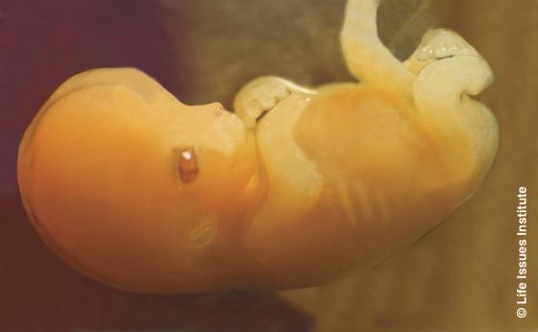
7 Weeks After Fertilization
The cerebrum, or largest part of the brain, has divided into hemispheres. [68] [69]
Muscles and nerves begin working together. When the upper lip is tickled, the arms move backwards. [70]

Slide 14
9 Weeks After Fertilization
More than 90% of the body structures found in a full-grown human are present. The medical classification changes from an embryo to a fetus. This dividing line was chosen by embryologists because from this point forward, most development involves growth in existing body structures instead of the formation of new ones. [72] [73]
The pre-birth human moves body parts without any outside stimulation. [74]

Slide 15
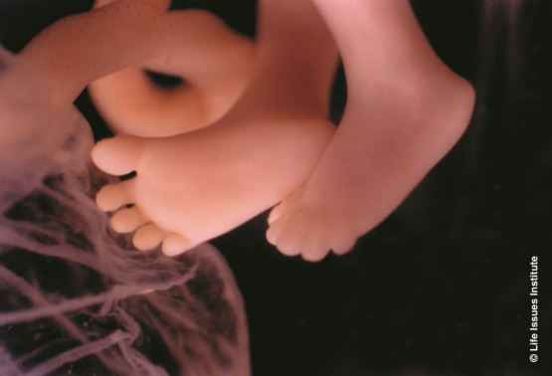
10 Weeks After Fertilization
All parts of the brain and spinal cord are formed. The heart pumps blood to every part of the body. [75]
The whole body is sensitive to touch except for portions of the head. The pre-birth human makes facial expressions. [76]

Slide 16
12 Weeks After Fertilization
Electrical signals from the nervous system are measurable. After an abortion, efforts to suckle will sometimes be observed. [78] [79]
14 Weeks After Fertilization
The pre-birth human makes coordinated movements of the arms and legs. [81]

Slide 17
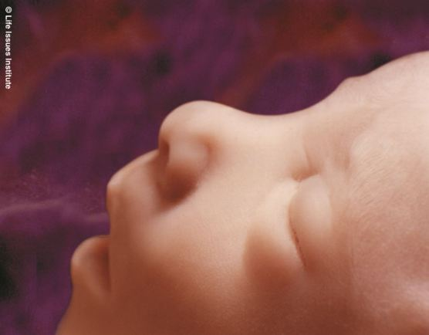
16 Weeks After Fertilization
The pre-birth human makes eye movements. [82]

Slide 18
18 Weeks After Fertilization
The portion of the brain responsible for functions such as reasoning, memory, and language (the cerebral cortex) has the same number of nerve cells as a full-grown adult. Pain sensory receptors have spread to all portions of the skin and mucous membranes. [84] [85]

Slide 19
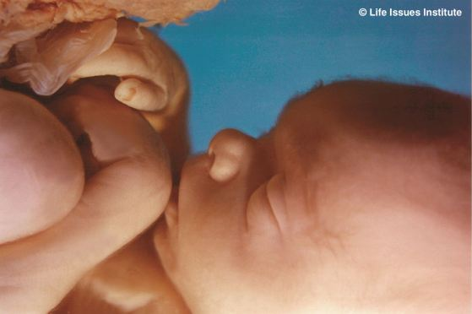
20 Weeks After Fertilization
The pre-birth human sleeps, awakes, and can hear sounds. [87]
For comprehensive facts about the capacity of humans to feel pain at this stage of development, read “Just Facts” article, “When Do Humans Begin to Feel Pain?”

Slide 20
24 Weeks After Fertilization
The blink-startle reflex and taste buds are functional. The pre-birth human will swallow more amniotic fluid if a sweetener is added to it. [95] [96]
The grip is strong enough to hold onto an object that is moving up and down. [97]
If born and given specialized care, the survival rate is more than 80%. [98]

Slide 21
28 Weeks after Fertilization
If exposed to an 85 decibel noise while sleeping (about as loud as a blender), pre-birth humans exhibit the “motor behaviors that accompany the crying state.” [99] [100]
Premature infants born at this time are more sensitive to pain than infants who are born at 38 weeks, and infants who are born at 38 weeks are more sensitive to pain than infants at 3–12 months after birth. [101] [102]
If born and given specialized care, the survival rate is more than 95%. [103]

Slide 22
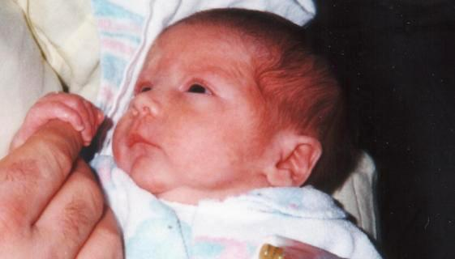
32 Weeks After Fertilization
38 Weeks After Fertilization
Average point in time when humans are born. At birth, the medical classification changes from a fetus to a neonate. [105] [106]

Slide 23
Abortion – What Does The Bible Say?
Life is a gift from God. Acts 17:25, “He giveth life and breath to all things.”
Abortion is the taking of “innocent blood!” Genesis 9:6; 1 Corinthians 6:9-10;
Galatians 5:19-21; Revelation 21:8; Exodus 20:13; 21:22-23; Romans 13:9
Proverbs 6:16-17, “There are six things which Jehovah hateth; yea, seven which are an abomination unto him: haughty eyes, a lying tongue, and hands that shed innocent blood …”

Slide 24
Abortion – What Does The Bible Say?
The Bible stresses “The Sanctity Of Life”
Genesis 1:26-27
Genesis 9:6, “Whoso sheddeth man’s blood, by man shall his blood be shed. For in the image of God made he man.” cf. Hebrews 12:9
Abortion Creates “A Culture of Death”!
Where will it all end?
  If we do not value the life of an unborn child …
  Will it lead us to “put to sleep” the aged, the infirm, the mental patient, the deformed, or diseased?
  Continue to instruct our young people in true moral values and biblical principles.
  Proverbs 14:34, “Righteousness exalteth a nation, but sin is a reproach to any people.”

Slide 25
Answer to Unwanted Pregnancy is NOT …
Defining the new child out of existence.
Adding violence upon violence.
Replacing the physical pain and trials of health problems with the mental, emotional, and psychological pain of abortion.
Discarding a new life because that new life is inconvenient or unwanted.
Adding sin upon sin – Willful sin: “I can repent later” Hebrews 10:26-27

Slide 26
The Answer To Unwanted Pregnancy
In 2019, unmarried women accounted for 86% of all abortions (CDC).
Respect the new life that now exists.
Look for godly solutions that honor the life of the child.
Repent of the fornication if that has occurred.
Acts 17:30

Slide 27
The Answer to One who has Already had an Abortion
God loves you and you can be forgiven.
Luke 23:34; Acts 2:36-38; 1 John 1:9
You can heal spiritually, emotionally, and psychologically. Philippians 4:6-7, 13, 19

Slide 28
Conclusion:
Jesus came to give us Life!
John 14:6, “I am the way, the truth, and the life: no man cometh unto the Father, but by me.”
John 1:4, “In him was life; and the life was the light of men.”
1 John 5:14, “He that hath the Son hath life; and he that hath not the Son of God hath not life.”

